Slide 1
Tests of Differences in Mean
NRES 776
Instructor: Heather Bryan
Oct 5, 2021

Slide 2
Learning Objectives
Perform tests of differences in mean
Detect deviations from assumption of normality
Decide what to do if your data do not meet assumptions of your test
Apply an appropriate transformation to your data
Conduct non-parametric and permutation tests for data that do not meet assumptions of normality and equal variances

Slide 3
Hypothesis testing on numerical variables
E.g., length, weight, speed
Which is larger, faster, longer?
Need to know probability distribution that these data are taken from
Many tests developed for variables that are normally distributed

Slide 4
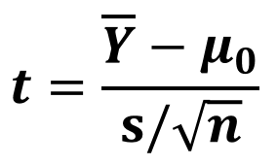

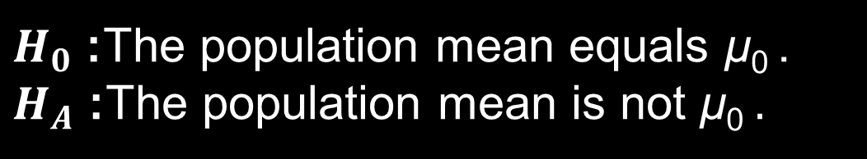
One-sample t-test
Testing an observed mean ($\overline{\text{Y} }$) against a parametric mean ($μ_{0})$
$H_{0}$: The population mean equals μ₀ .
$H_{A}$: The population mean is not μ₀$.$
Notes:
-many statistical methods are developed for making inferences on and testing hypotheses about variables with a normal distribution
-one of the simplest hypothesis tests is a one-sample t-test
-goal is to compare whether measurements on a sample are consistent with a hypothesized value for a population

Slide 5
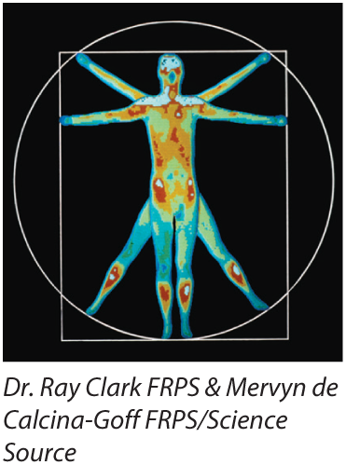
One-sample t-test example
Are body temperatures of 25 randomly sampled individuals consistent with an average temperature of 98.6°F?

Slide 6



One-sample t-test example
$H_{0}$: Mean human body temperature is 98.6°F ($μ_{0}$= 98.6)
$H_{A}$: Mean human body temperature is not 98.6°F
($μ_{0}≠$ 98.6)
$\overline{\text{Y} }$= 98.524, s = 0.678, n = 25
$$t=\frac{\overline{Y}−μ_{0}}{s/√n}=\frac{98.524−98.6}{0.678/√25}=−0.56$$
Using R: 2*pt(0.56,df=24, lower.tail=FALSE)
p = 0.58

Slide 7
One-sample t-test example
Conclusion: Fail to reject the null hypothesis (t = -0.56, df = 24, p = 0.58). Mean body temperature is consistent with 98.6 °F.

Slide 8
One-sample t-test assumptions
Data are a random sample from the population (always an assumption)
Variable is normally distributed

Slide 9
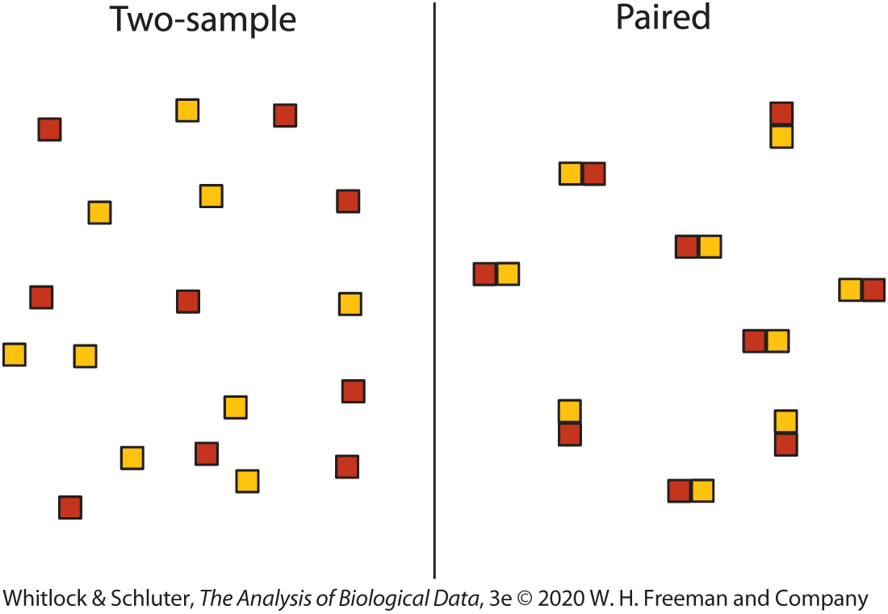
Comparing two means

Slide 10
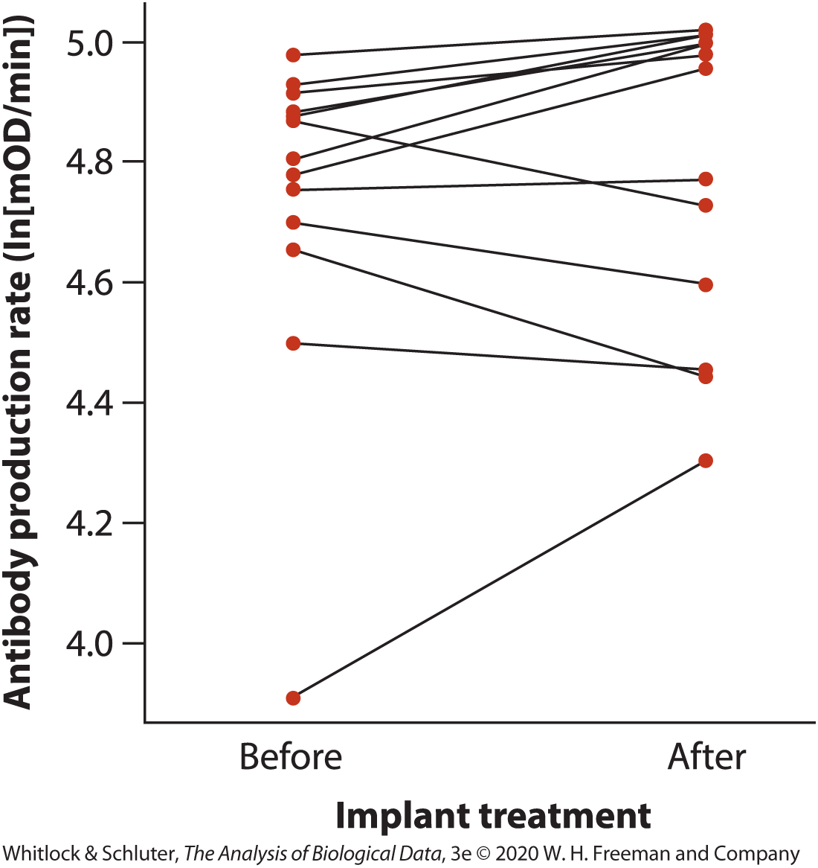
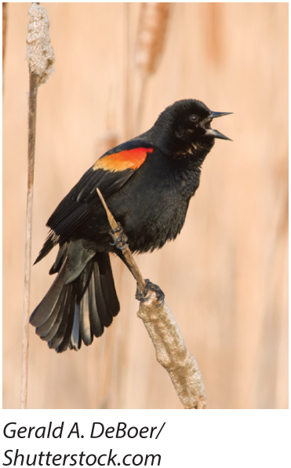
Paired comparisons of means
Notes:
-many statistical methods are developed for making inferences on and testing hypotheses about variables with a normal distribution
-one of the simplest hypothesis tests is a one-sample t-test
-goal is to compare whether measurements on a sample are consistent with a hypothesized value for a population

Slide 11
Paired comparisons of means
Table 12.2-1, Antibody production rate in blackbirds before and after testosterone implants. Each bird is represented by a single row and has a pair of antibody measurements; d is the difference (“after” minus “before”) between the pair of measurements., Page 306
Male identification number | Before implant: Antibody production (ln[mOD/min]) | After implant: Antibody production (ln[mOD/min]) | d
1 | 4.65 | 4.44 | −0.021
4 | 3.91 | 4.30 | 0.39
5 | 4.91 | 4.98 | 0.07
6 | 4.50 | 4.45 | −0.05
9 | 4.80 | 5.00 | 0.20
10 | 4.88 | 5.00 | 0.12
15 | 4.88 | 5.01 | 0.13
16 | 4.78 | 4.96 | 0.18
17 | 4.98 | 5.02 | 0.04
19 | 4.87 | 4.73 | −0.14
20 | 4.75 | 4.77 | 0.02
23 | 4.70 | 4.60 | −0.10
24 | 4.93 | 5.01 | 0.08

Slide 12



Confidence Interval of Difference
$${\overline{d}}_{CI}=\overline{d}±t_{α,n−1}{SE}_{\overline{d}}$$
$$\overline{d}=0.056$$
$${SE}_{\overline{d}}=0.044$$
$$n=13$$
95% CI
$$−0.040<\overline{d}<0.152$$
Whitlock & Schluter (2015)

Slide 13

Paired comparisons of means
$H_{0}$: Mean change in antibody production after testosterone implants was zero ($μ_{d}=0)$
$H_{A}$: Mean change in antibody production after testosterone implants was not 0 ($μ_{d}≠0)$

Slide 14

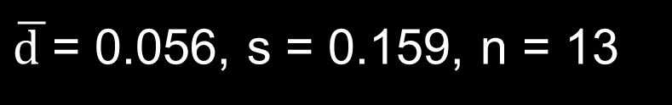
Paired comparisons of means
$H_{0}$: Mean change in antibody production after testosterone implants was zero ($μ_{d}=0)$
$H_{A}$: Mean change in antibody production after testosterone implants was not 0 ($μ_{d}≠0)$
$\overline{\text{d} }$= 0.056, s = 0.159, n = 13
$$t=\frac{\overline{d}−μ_{d0}}{s/√n}=\frac{0.056−0}{0.159/√13}=1.27$$
Using R: 2*pt(1.27,df=12, lower.tail=FALSE)
p = 0.23

Slide 15
Paired comparisons of means Interpretation
Fail to reject the null hypothesis
Mean difference is in the direction of higher immune system function after testosterone implants, but we cannot reject the null hypothesis that testosterone has no effect on immunocompetence

Slide 16
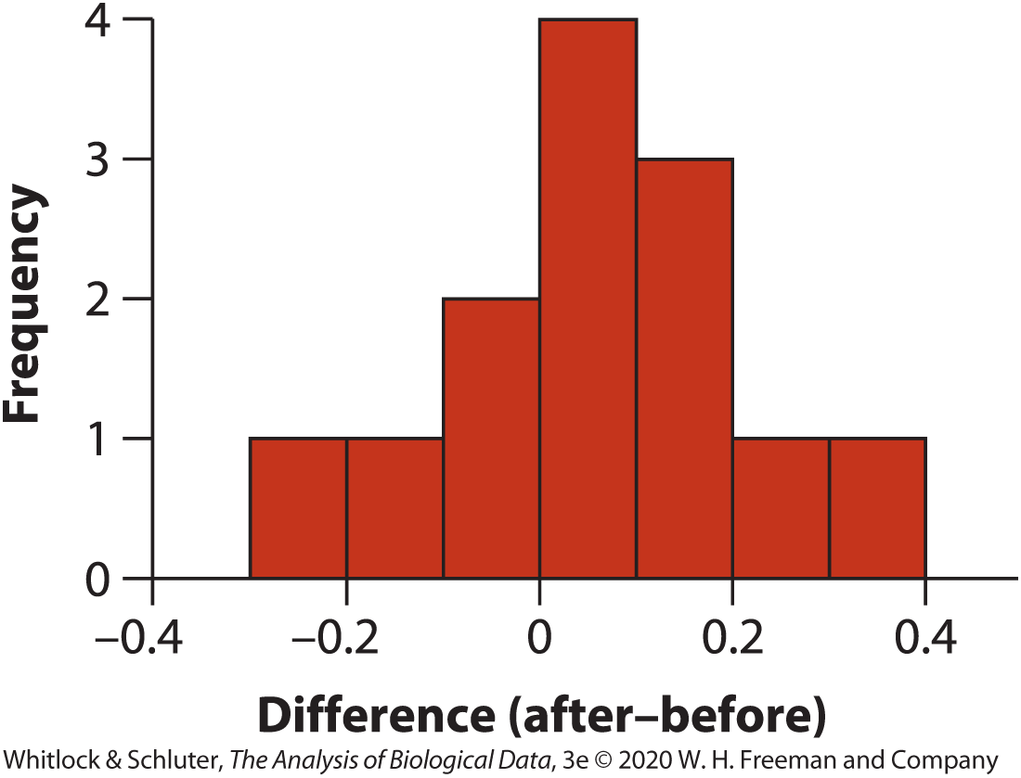
Paired comparisons of means
Assumptions:
Differences are normally distributed
Random sample of pairs

Slide 17
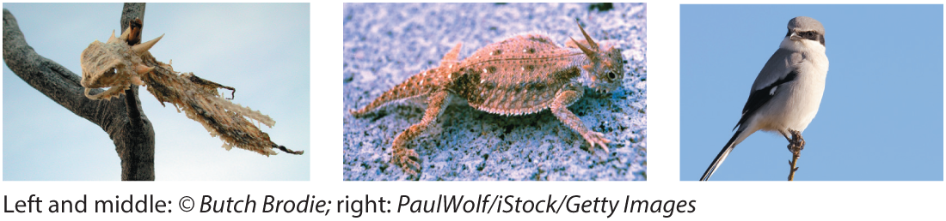
Two-sample comparison of means
Treatments applied to separate, independent samples from two populations

Slide 18
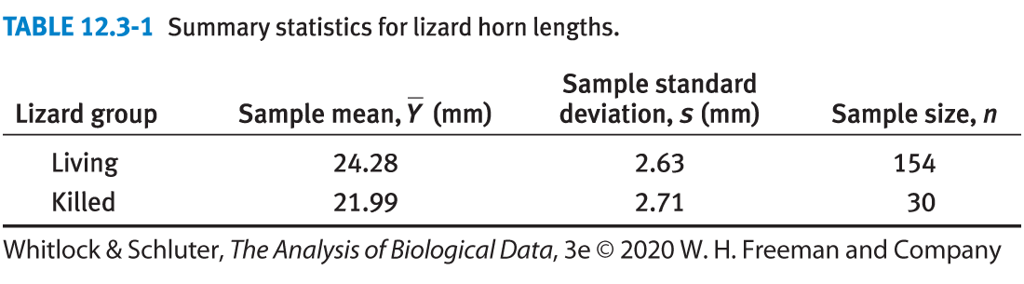
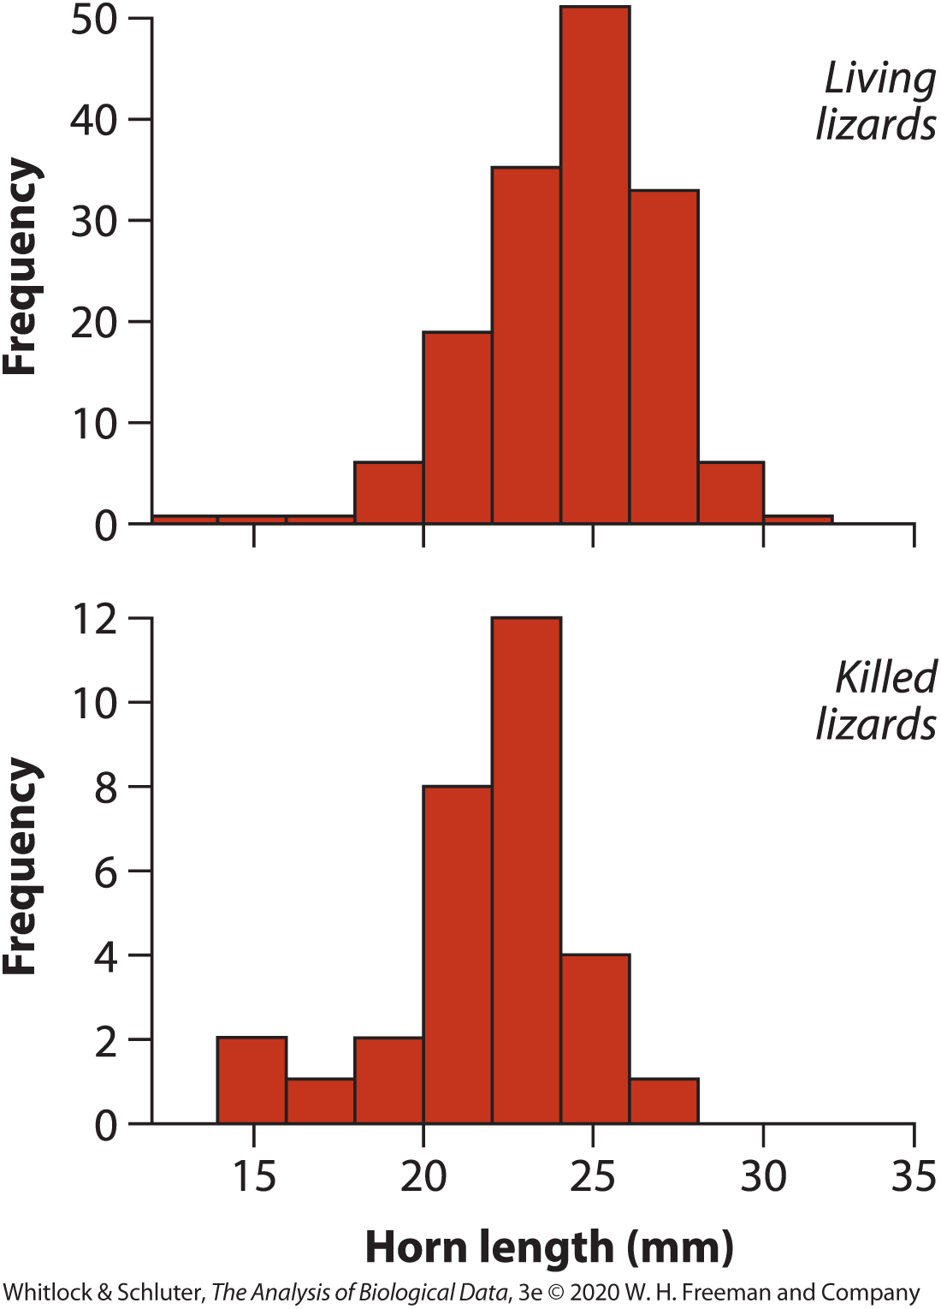
Two-sample comparison of means

Slide 19

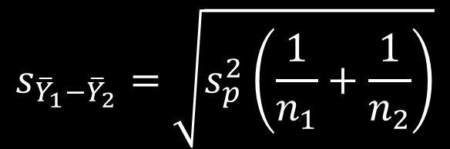




Confidence Interval for the Difference between Means
Difference between means: ${\overline{Y}}_{1}−$ ${\overline{Y}}_{2}$
$$s_{{\overline{Y}}_{1}−{\overline{Y}}_{2}}=\sqrt{s_{p}^{2}\left(\frac{1}{n_{1}}+\frac{1}{n_{2}}\right)}$$
Standard error of means:
$$s_{p}^{2}=\frac{{df}_{1}s_{1}^{2}+{df}_{2}s_{2}^{2}}{{df}_{1}+{df}_{2}}$$
Pooled sample variance:
Degrees of freedom:
$${df}_{1}=n_{1}−1$$
$${df}_{2}=n_{2}−1$$
$$df=n_{1}+n_{2}−2$$

Slide 20






Confidence Interval for the Difference between Means
$${CI}_{{\overline{Y}}_{1}−{\overline{Y}}_{2}}={(\overline{Y}}_{1}−{\overline{Y}}_{2})±t_{α,{df}_{1}+{df}_{2}}{×s}_{{\overline{Y}}_{1}−{\overline{Y}}_{2}}$$
$${\overline{Y}}_{1}−{\overline{Y}}_{2}=28.28−21.99=2.29$$
$s_{p}^{2}=\frac{{df}_{1}s_{1}^{2}+{df}_{2}s_{2}^{2}}{{df}_{1}+{df}_{2}}$ = $\frac{153({2.63}^{2})+29{(2.71}^{2})}{153+29}=6.98$
$s_{{\overline{Y}}_{1}−{\overline{Y}}_{2}}=\sqrt{s_{p}^{2}\left(\frac{1}{n_{1}}+\frac{1}{n_{2}}\right)=\sqrt{6.98\left(\frac{1}{154}+\frac{1}{30}\right)}}$ = 0.527
$${df}_{1}+{df}_{2}−2=182$$
$$t_{0.05(2),182}=1.97$$
$${95\%CI}_{{\overline{Y}}_{1}−{\overline{Y}}_{2}}=2.99±1.97×0.527$$
$${1.25<\overline{Y}}_{1}−{\overline{Y}}_{2}<3.33$$

Slide 21


Two-sample t-test for the Difference between Means
$H_{0}$: Lizards killed by shrikes and living lizards do not differ in horn length ($μ_{1}=μ_{2})$
$H_{A}$: Lizards killed by shrikes and living lizards differ in horn length($μ_{1}≠μ_{2})$
$$t=\frac{{\overline{Y}}_{1}−{\overline{Y}}_{2}}{s_{{\overline{Y}}_{1}−{\overline{Y}}_{2}}}$$
standard error based on pooled sample variance
Whitlock & Schluter (2015)

Slide 22






Two-sample t-test for the Difference between Means
$${\overline{Y}}_{1}−{\overline{Y}}_{2}=2.29$$
$$s_{{\overline{Y}}_{1}−{\overline{Y}}_{2}}=0.527$$
$${df}_{1}+{df}_{2}=182$$
$$t=\frac{2.29}{0.527}=4.35$$
$$P=0.000023$$
P < 0.001
$$t_{182}$$

Slide 23
Two-sample t-test Interpretation
Reject the null hypothesis
There is evidence of a difference in horn length of living versus killed lizards based on this sample. Horn length was larger in live versus killed lizards.

Slide 24
Two-sample t-test Assumptions
Both samples are randomly sampled from their populations
Variables follow a Normal distribution in each population
The variance of the variable is the same in both populations

Slide 25


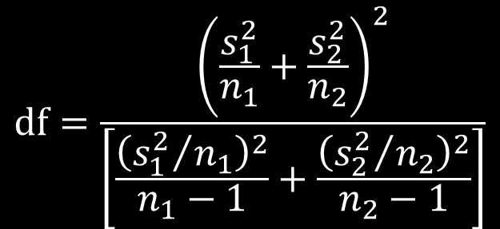
Two-sample t-test: unequal variances
aka: Welch’s approximate t-test
$$t=\frac{{\overline{Y}}_{1}−{\overline{Y}}_{2}}{s_{{\overline{Y}}_{1}−{\overline{Y}}_{2}}}$$
$$df=\frac{{\left(\frac{s_{1}^{2}}{n_{1}}+\frac{s_{2}^{2}}{n_{2}}\right)}^{2}}{\left[\frac{{\left({s_{1}^{2}}/{n_{1}}\right)}^{2}}{n_{1}−1}+\frac{{\left({s_{2}^{2}}/{n_{2}}\right)}^{2}}{n_{2}−1}\right]}$$
$$s_{{\overline{Y}}_{1}−{\overline{Y}}_{2}}=\sqrt{\frac{s_{1}^{2}}{n_{1}}+\frac{s_{2}^{2}}{n_{2}}}$$
Whitlock & Schluter (2015)

Slide 26
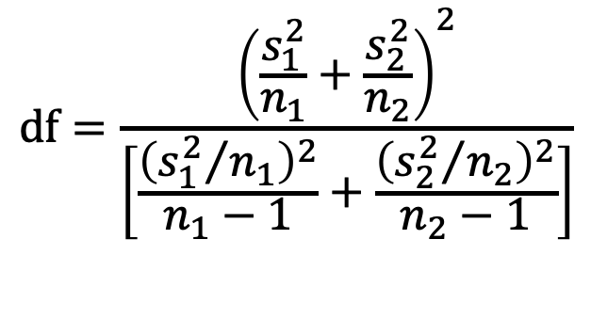

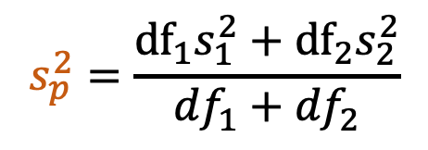

Standard error
equal variance
unequal variance
$$s_{{\overline{x}}_{1}−{\overline{x}}_{2}}=\sqrt{s_{p}^{2}\left(\frac{1}{n_{1}}+\frac{1}{n_{2}}\right)}$$
$$s_{{\overline{x}}_{1}−{\overline{x}}_{2}}=\sqrt{\frac{s_{1}^{2}}{n_{1}}+\frac{s_{2}^{2}}{n_{2}}}$$
$$s_{p}^{2}=\frac{{df}_{1}s_{1}^{2}+{df}_{2}s_{2}^{2}}{{df}_{1}+{df}_{2}}$$
$$df=\frac{{\left(\frac{s_{1}^{2}}{n_{1}}+\frac{s_{2}^{2}}{n_{2}}\right)}^{2}}{\left[\frac{{\left({s_{1}^{2}}/{n_{1}}\right)}^{2}}{n_{1}−1}+\frac{{\left({s_{2}^{2}}/{n_{2}}\right)}^{2}}{n_{2}−1}\right]}$$
$${df}_{1}=n_{1}−1$$
$${df}_{2}=n_{2}−1$$
$$df=n_{1}+n_{2}−2$$
Whitlock & Schluter (2015)

Slide 27

Comparing Variances
F-test of equal variances: H₀: ($σ_{1}=σ_{2})$
H_{A}: ($σ_{1}≠σ_{2})$
F = $\frac{s_{1}^{2}}{s_{2}^{2}}$, F-distribution, df = n-1, n-2
Levene’s Test for Homogeneity of Variances
More robust to departures from normality
Available in many statistical software packages

Slide 28
What if data aren’t normal or variances aren’t equal?
Ignore violations
Some tests are relatively robust to violations (e.g., t-test, ANOVAs) especially with large sample sizes
2. Transform the data
E.g., log transformation
3. Use non-parametric methods
no assumptions of normality, outliers not a problem
4. Use a permutation test
computer generates null distribution for a test statistic and randomly rearranges the data for one of the variables

Slide 29
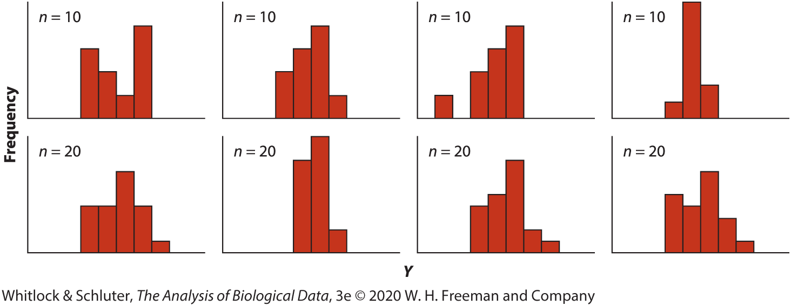
Detecting deviations from normality: Histograms
Samples drawn from normal distribution
Note variation and effect of sample size

Slide 30
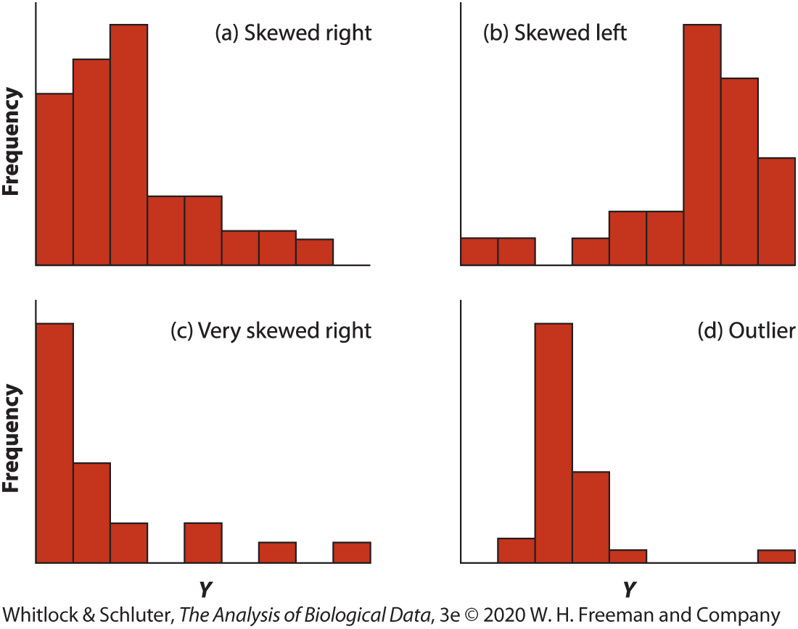
Detecting deviations from normality: Histograms
Samples drawn from non-normal distributions

Slide 31
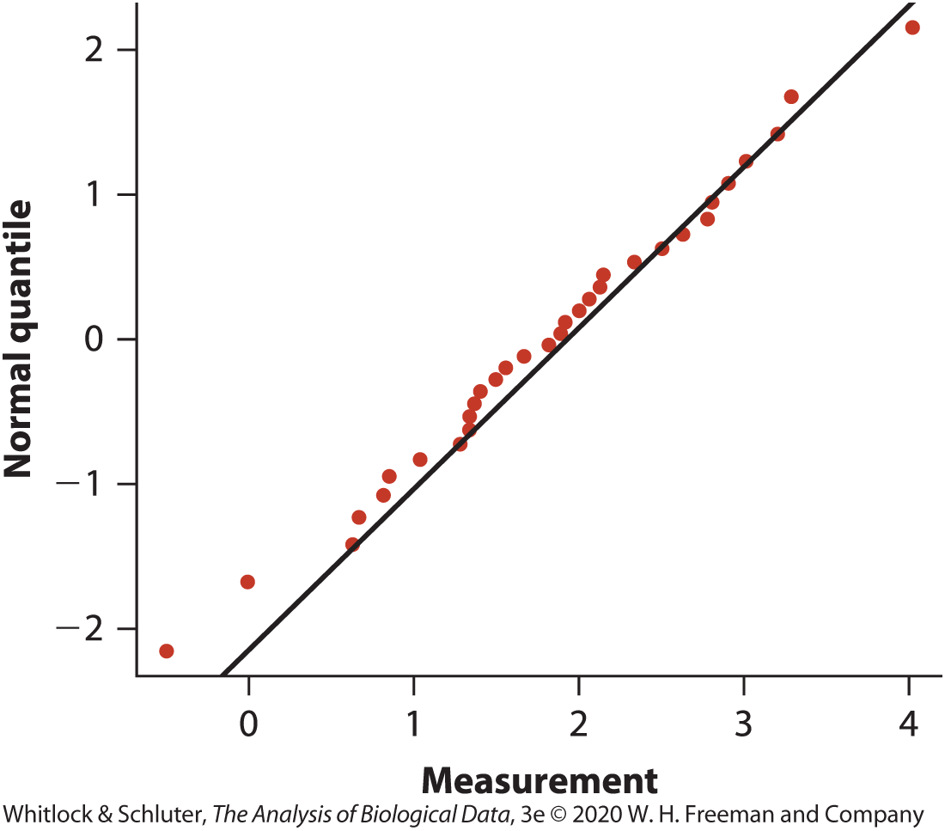
Detecting deviations from normality: Q-Q Plot
Notes:
-compares each observation in sample with what would be expected with corresponding quantile under normal distribution

Slide 32
Detecting deviations from normality: Tests
H₀: The data are sampled from a population having a normal distribution
H₁: The data are sampled from a population not having a normal distribution

Slide 33
Detecting deviations from normality: Tests
H₀: The data are sampled from a population having a normal distribution
H₁: The data are sampled from a population not having a normal distribution
E.g., Shapiro-Wilk test
Calculates the mean and standard deviation of the sample data and tests the goodness-of-fit of the data to the normal distribution with same mean and standard deviation
Performed in most software packages

Slide 34
When to ignore violations of assumptions?
Normality
Depends on robustness of test
i.e., whether violations of assumptions change the results
Comparisons of means (e.g., ANOVA, t-test) generally robust for large samples
Why?

Slide 35
When to ignore violations of assumptions?
Depends on how similar distributions of groups are
Outliers
Notes:
-if both groups have distributions as in (a), then n=30 for accurate t-test results
-would need samples size of 500 per group to get accurate answers for comparing groups with distributions in (a) and (b)
-distribution in panel c is too skewed to be analyzed with t-test
-data with outliers in (d) also should not be analyzed with t-test
-overall should use cautionary approach and turn to transformations, non-parametric methods, or permutations

Slide 36
When to ignore violations of assumptions?
Unequal variances
If n>30 in each group
balanced design
differences in standard deviation are less than 3-fold
Assumption of normality is met

Slide 37
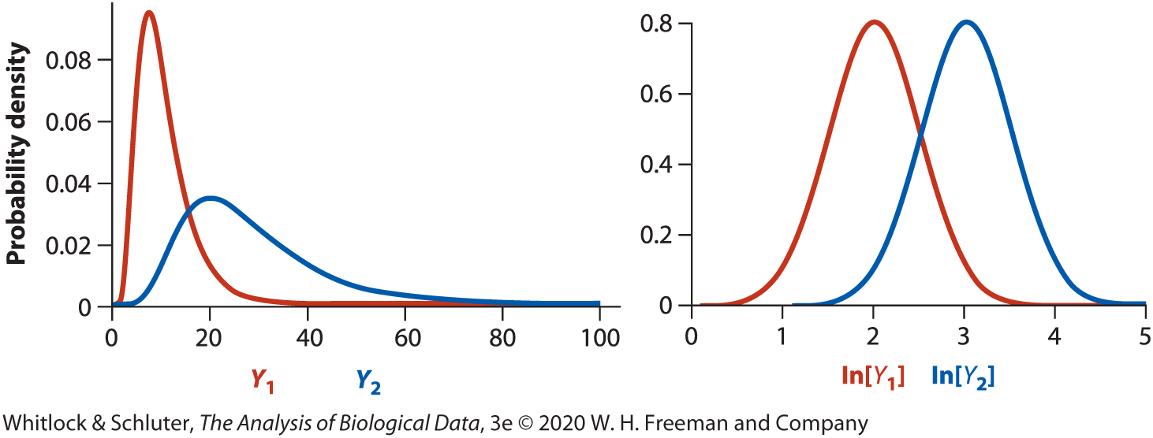
Data Transformations: log
Right-skewed data (e.g., body mass)
Population with higher mean also has higher standard deviation (e.g., elephant vs. mouse body size)
Data span orders of magnitude (e.g., abundance)
Y’ = ln[Y], back-transform Y = e^{Y’}

Slide 38
Data Transformations: arcsine
Proportions
Tend to be non-normally distributed and unequal standard deviations
p’ = arcsin$[√p]$

Slide 39

Data Transformations: square root
Count data (e.g., number eggs laid)
Y’ = $\sqrt{Y+1/2}$
Can help equalize different standard deviations between groups

Slide 40
Notes on using transformations
Often makes sense to back-transform descriptive statistics, confidence intervals, and regression coefficients that have been calculated on transformed data
E.g., For log transformation Y = e^{Y’}
Try multiple transformations, but no p-hacking! (i.e., don’t choose a different transformation because it gives significant results)

Slide 41
Nonparametric alternatives: sign test
Used for one-sample or paired t-test when normality assumption is not met
Tests whether the median of a population equals a null hypothesized value
Assign values above the hypothesized value a + and values below a –
Use binomial test to evaluate whether the proportion of + and – differs from p = 0.5

Slide 42
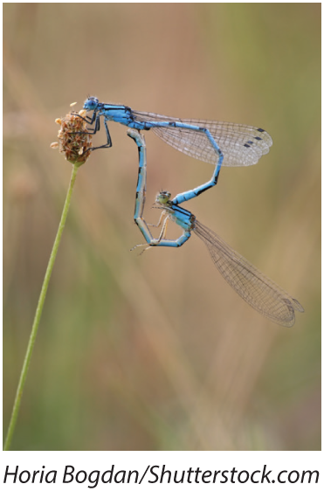
Nonparametric alternatives: sign test
E.g., sexual conflict and speciation rates

Slide 43
 | Number of species | Number of species
Taxon pair | Multiple-mating group | Single-mating group | Difference | Above (+) or below (−) zero
A | 53 | 10 | 43 | +
B | 73 | 120 | -47 | -
C | 228 | 74 | 154 | +
D | 353 | 289 | 64 | +
E | 157 | 30 | 127 | +
F | 300 | 4 | 296 | +
G | 34 | 18 | 16 | +
H | 3400 | 3500 | -100 | -
I | 20 | 1000 | -980 | -
J | 196 | 486 | -290 | -
K | 1750 | 660 | 1090 | +
L | 55 | 63 | -8 | -
M | 37 | 115 | -78 | -
N | 100 | 30 | 70 | +
O | 21,000 | 600 | 20,400 | +
P | 37 | 40 | -3 | -
Q | 7 | 5 | 2 | +
R | 15 | 7 | 8 | +
S | 18 | 6 | 12 | +
T | 240 | 13 | 227 | +
U | 15 | 14 | 1 | +
V | 77 | 16 | 61 | +
W | 15 | 14 | 1 | +
X | 85 | 6 | 79 | +
Y | 86 | 8 | 78 | +

Slide 44
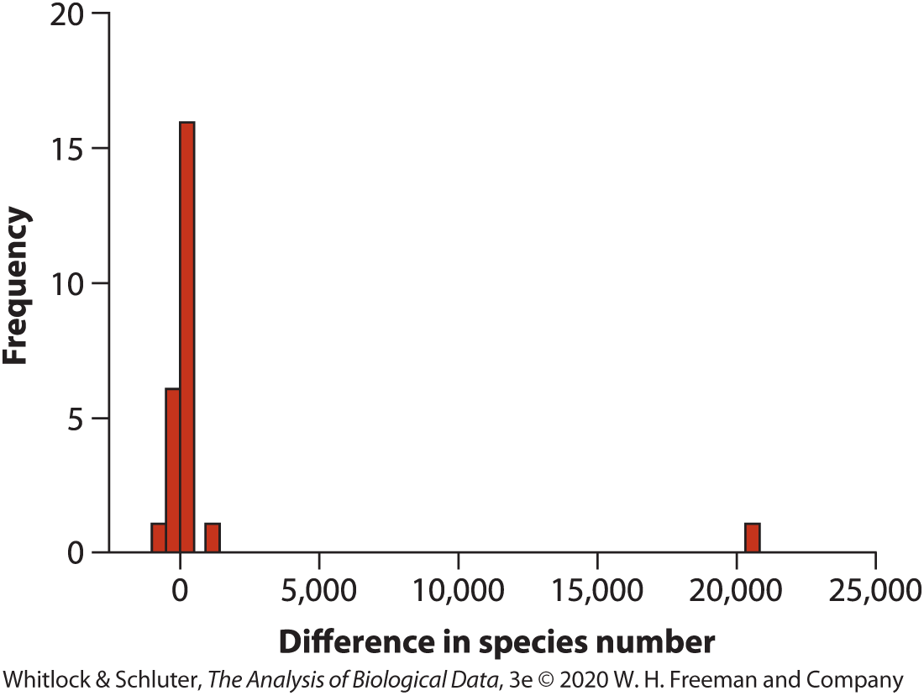
Nonparametric alternatives: sign test
E.g., sexual conflict and speciation rates

Slide 45

Nonparametric alternatives: sign test
E.g., sexual conflict and speciation rates
H₀: The median difference in number of species between insect groups is zero $(m_{d}=0)$
H₁: The median difference in number of species between these groups is not zero $(m_{d}≠0)$

Slide 46
 | Number of species | Number of species
Taxon pair | Multiple-mating group | Single-mating group | Difference | Above (+) or below (−) zero
A | 53 | 10 | 43 | +
B | 73 | 120 | -47 | -
C | 228 | 74 | 154 | +
D | 353 | 289 | 64 | +
E | 157 | 30 | 127 | +
F | 300 | 4 | 296 | +
G | 34 | 18 | 16 | +
H | 3400 | 3500 | -100 | -
I | 20 | 1000 | -980 | -
J | 196 | 486 | -290 | -
K | 1750 | 660 | 1090 | +
L | 55 | 63 | -8 | -
M | 37 | 115 | -78 | -
N | 100 | 30 | 70 | +
O | 21,000 | 600 | 20,400 | +
P | 37 | 40 | -3 | -
Q | 7 | 5 | 2 | +
R | 15 | 7 | 8 | +
S | 18 | 6 | 12 | +
T | 240 | 13 | 227 | +
U | 15 | 14 | 1 | +
V | 77 | 16 | 61 | +
W | 15 | 14 | 1 | +
X | 85 | 6 | 79 | +
Y | 86 | 8 | 78 | +

Slide 47
Nonparametric alternatives: sign test
Use binomial test
Expect p = 0.5 above and below 0
18/25 fall above 0, 7 below
$$P(x)=\left({n \atop x}\right)p^{x}{\left(1−p\right)}^{n−x}$$
$$P\left(x≤7\right)=\sum_{i=0}^{7}{\left({25 \atop i}\right)}{0.5}^{i}{\left(1−0.5\right)}^{25−i}=0.02164$$
P = 2*0.02164 = 0.043
Notes:
Binomial test tests whether a population proportion matches a null expectation for the proportion
-calculates the probability of getting a result as extreme as or more extreme than the observed proportion

Slide 48
Nonparametric alternatives: sign test
Reject H₀. Groups of insects whose females mate multiple times have more species than groups whose females mate singly, consistent with sexual-conflict hypothesis.

Slide 49
Nonparametric alternatives to two-sample t-test: Mann-Whitney U-test
Data ranked from smallest to largest
Tests whether frequency distributions of the two groups are the same

Slide 50
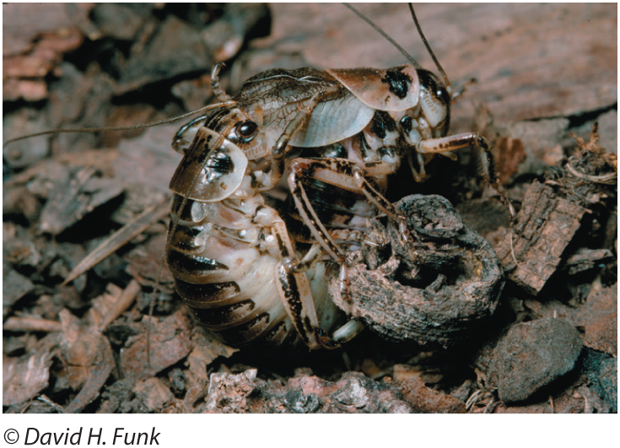
Nonparametric alternatives to two-sample t-test: Mann-Whitney U-test
E.g., sexual cannibalism in sagebrush crickets
Notes:
-male offers hind wings to females to eat during mating
-males whose wings have been eaten are less likely to be chosen by subsequent females
-Research question is: are females more likely to mate if they are hungry?
-experiment starved 11 females for two days and compared with another group of 13 females that were fed during the same period
-females were placed in a cage with a single, new male, and waiting time to mating was recorded

Slide 51
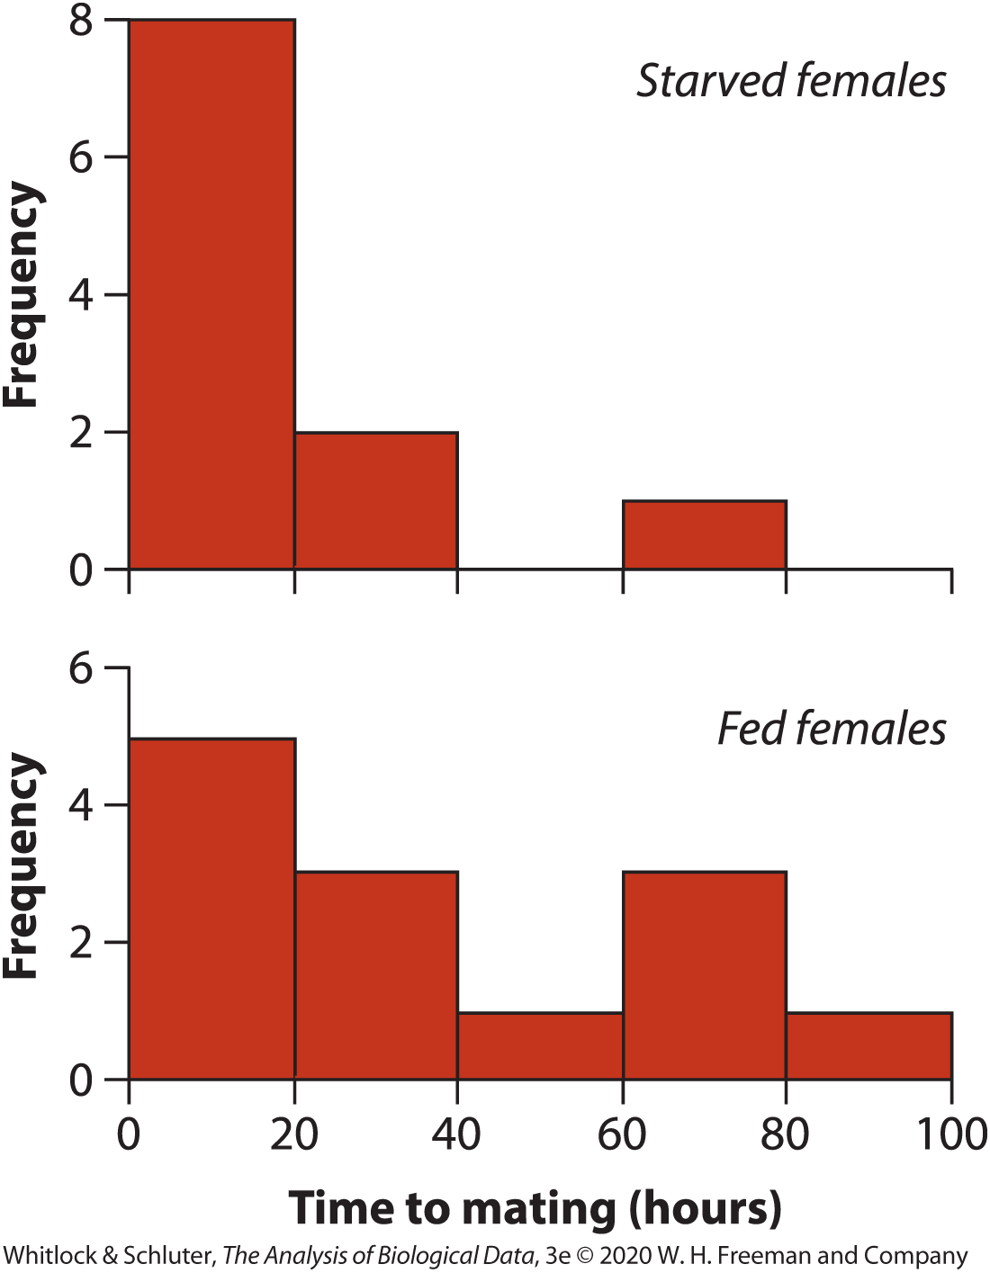
Nonparametric alternatives to two-sample t-test: Mann-Whitney U-test
Starved | Fed
1.9 | 1.5
2.1 | 1.7
3.8 | 2.4
9.0 | 3.6
9.6 | 5.7
13.0 | 22.6
14.7 | 22.8
17.9 | 39.0
21.7 | 54.4
29.0 | 72.1
72.3 | 73.6
 | 79.5
 | 88.9
Median: 13 22.8
Notes:
-median time to mating was 13 hours for starved females and 22.8 hours for fed females

Slide 52
Nonparametric alternatives to two-sample t-test: Mann-Whitney U-test
E.g., sexual cannibalism in sagebrush crickets
H₀: The distribution of time to mating is the same for female crickets that were starved and for those that were fed $(D_{1}=D_{2})$
H₁: The distribution of time to mating differs between the two groups$(D_{1}≠D_{2})$

Slide 53
Table 13.5-2, Times to mating of female crickets from both groups, ordered from smallest to largest and then ranked. Data from group 2 (fed crickets) are highlighted in red to facilitate comparison., Page 391
Group | Time to mating | Rank
2 | 1.5 | 1
2 | 1.7 | 2
1 | 1.9 | 3
1 | 2.1 | 4
2 | 2.4 | 5
2 | 3.6 | 6
1 | 3.8 | 7
2 | 5.7 | 8
1 | 9.0 | 9
1 | 9.6 | 10
1 | 13.0 | 11
1 | 14.7 | 12
1 | 17.9 | 13
1 | 21.9 | 14
2 | 22.6 | 15
2 | 22.8 | 16
1 | 29.0 | 17
2 | 39.0 | 18
2 | 54.4 | 19
2 | 72.1 | 20
1 | 72.3 | 21
2 | 73.6 | 22
2 | 79.5 | 23
2 | 88.9 | 24

Slide 54
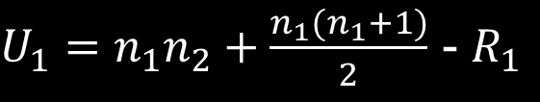

Nonparametric alternatives to two-sample t-test: Mann-Whitney U-test
Sort data in both groups from smallest to largest and assign ranks
Calculate the rank sum for one of the groups (e.g., starved group)
R1 = 3 + 4 + 7 + 9 + 10 + 11 + 12 + 13 + 14 + 17 + 21 = 121
3) Calculate U1: number of times rank in group 1 is smaller than group 2
$U_{1}=n_{1}n_{2}+\frac{n_{1}(n_{1}+1)}{2}$ - $R_{1}$
$$U_{2}=n_{1}n_{2}−U_{1}$$
$U_{1}=11(13) +\frac{11 (11+1)}{2}$ - $121$= 88
$$U_{2}=11\left(13\right)−88=55$$

Slide 55
Nonparametric alternatives to two-sample t-test: Mann-Whitney U-test
4) Choose the larger of U₁, U₂ (88)
5) Determine the p-value from Mann-Whitney U Distribution U_{0.05(2),11,13} = 106, p>0.05
6) Fail to reject H₀. Insufficient evidence that the distribution of time to mating is different between starved and fed female crickets.

Slide 56
Assumptions of non-parametric tests
Random sampling
Make sure you know what you are testing (e.g., Mann-Whitney U test compares distributions, not necessarily locations unless distributions have same shape)

Slide 57
Type I and II error rates of nonparametric methods
Parametric and non-parametric approaches generally have similar Type I error rates (probability of rejecting a true null hypothesis) when assumptions are met
Type I error rates go up for parametric tests when assumptions are not met
Non-parametric tests have lower power (ability to detect a difference if there is one), so if assumptions are met, it’s better to use parametric tests

Slide 58
Permutation tests
Computer-intensive method for testing hypotheses when data are non-normal
Can be used to test a variety of hypotheses (e.g., two-sample tests, associations between categorical or numerical variables, and more complex analyses)
Involve randomly re-arranging (permuting) data many times and comparing the observed test statistic with what would be expected based on a random sample

Slide 59
Table 13.8-1, Times to mating (in hours) of female sagebrush crickets that were recently starved or fed. Data from the two treatments are color-coded to more easily identify the origin of each value later in Table 13.8-2., Page 396
Treatment | Time (hours) | Treatment | Time (hours)
Starved | 1.9 | Fed | 1.5
Starved | 2.1 | Fed | 1.7
Starved | 3.8 | Fed | 2.4
Starved | 9.0 | Fed | 3.6
Starved | 9.6 | Fed | 5.7
Starved | 13.0 | Fed | 22.6
Starved | 14.7 | Fed | 22.8
Starved | 17.9 | Fed | 39.0
Starved | 21.7 | Fed | 54.4
Starved | 29.0 | Fed | 72.1
Starved | 72.3 | Fed | 73.6
 |  | Fed | 79.5
 |  | Fed | 88.9
Mean | 17.73 | Mean | 35.98

Slide 60
Permutation test example
H₀: Mean time to mating is the same for female crickets that were starved and for those that were fed
H₁: Mean time to mating differs between groups

Slide 61
Table 13.8-1, Times to mating (in hours) of female sagebrush crickets that were recently starved or fed. Data from the two treatments are color-coded to more easily identify the origin of each value later in Table 13.8-2., Page 396
Treatment | Time (hours) | Treatment | Time (hours)
Starved | 1.9 | Fed | 1.5
Starved | 2.1 | Fed | 1.7
Starved | 3.8 | Fed | 2.4
Starved | 9.0 | Fed | 3.6
Starved | 9.6 | Fed | 5.7
Starved | 13.0 | Fed | 22.6
Starved | 14.7 | Fed | 22.8
Starved | 17.9 | Fed | 39.0
Starved | 21.7 | Fed | 54.4
Starved | 29.0 | Fed | 72.1
Starved | 72.3 | Fed | 73.6
 |  | Fed | 79.5
 |  | Fed | 88.9
Mean | 17.73 | Mean | 35.98

Slide 62
Permutation test example
H₀: Mean time to mating is the same for female crickets that were starved and for those that were fed
H₁: Mean time to mating differs between groups
Original Sample
${\overline{Y}}_{1}$-${\overline{Y}}_{2}$ = 17.73-35.98 = -18.26

Slide 63
Table 13.8-2, Outcome of a single permutation. Response measurements (time to mating) are color-coded as in Table 13.8-1 to indicate their original groups., Page 397
Treatment | Time (hours) | Treatment | Time (hours)
Starved | 3.8 | Fed | 14.7
Starved | 9.0 | Fed | 21.7
Starved | 3.6 | Fed | 1.7
Starved | 79.5 | Fed | 2.1
Starved | 17.9 | Fed | 1.5
Starved | 22.8 | Fed | 2.4
Starved | 54.4 | Fed | 5.7
Starved | 13.0 | Fed | 39.0
Starved | 9.6 | Fed | 29.0
Starved | 1.9 | Fed | 72.1
Starved | 22.6 | Fed | 88.9
 |  | Fed | 72.3
 |  | Fed | 73.6
Mean | 21.65 | Mean | 32.67

Slide 64
Permutation test example
H₀: Mean time to mating is the same for female crickets that were starved and for those that were fed
H₁: Mean time to mating differs between groups
Original sample:
${\overline{Y}}_{1}$-${\overline{Y}}_{2}$ = 17.73-35.98 = -18.26
Permuted sample:
${\overline{Y}}_{1}$-${\overline{Y}}_{2}$ = 21.65-32.67 = -11.02

Slide 65
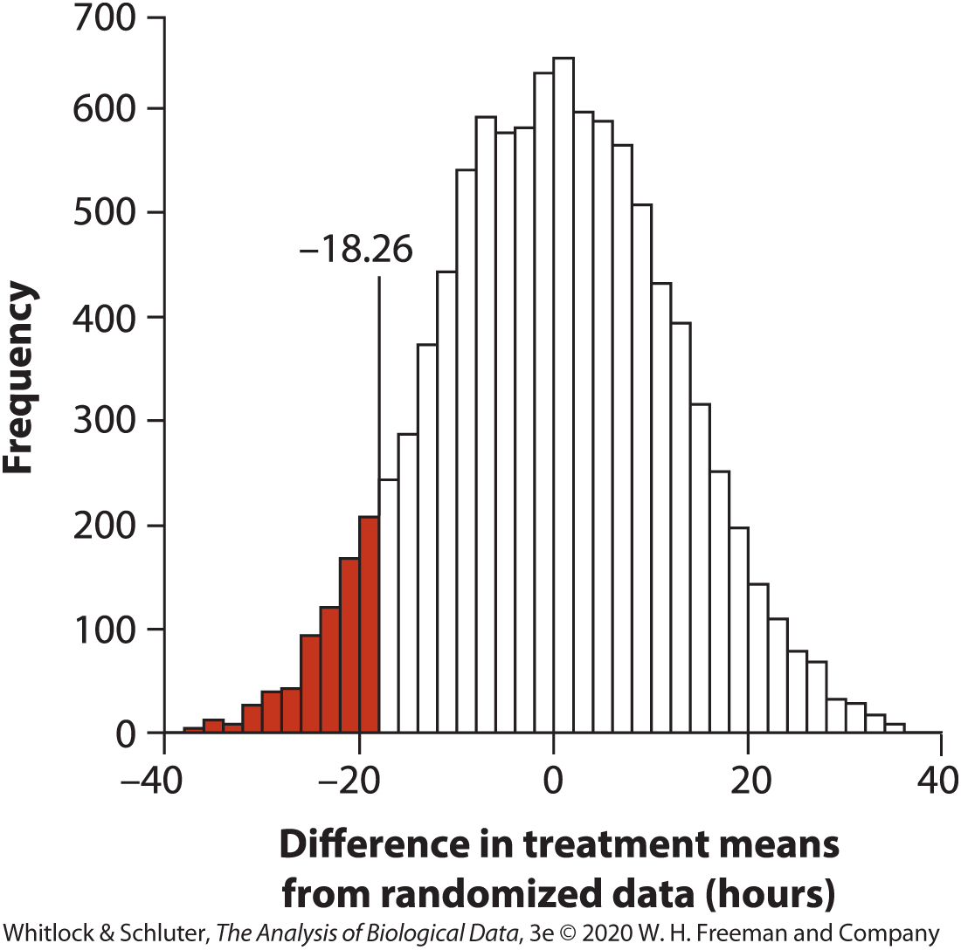
Permutation test example
712/10000 permutations led to observed difference in means of -18.26 or more extreme
P = 2*0.0712 = 0.142
Fail to reject H₀

Slide 66
Assumptions of permutation tests
Few assumptions, widely applicable
Random sample
Distribution of variable must have same shape in both populations
Lower power than parametric tests when sample sizes are small, but more powerful than Mann-Whitney U test
Similar power as parametric tests when sample sizes are large

Slide 67
Summary
What to do if assumptions of your test are violated?
Ignore minor violations if statistical method is robust
Transform data to better meet assumptions
Use a non-parametric test
Use a permutation test

